Slide 1

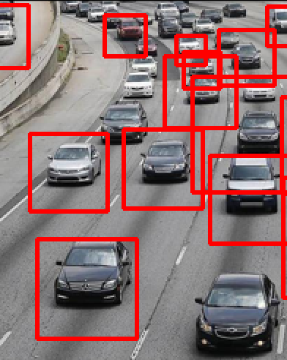
PS-8​Vehicle Cut in Detection (intel Unnati)
Project Mentor: Dr. M. Safa
Intel Mentor: Mr. Ramakrishna Madhava
P
Varnika Gupta, RA2211028010072
vg7869@srmist.edu.in
SRMIST

Slide 2
Approach
Data Collection and Preprocessing
Object Detection
Object Depth Detection
Time to Collision Calculation
Collecting data from IDD
Preprocessing the data into images and annotations
Splitting the data into train and val
Applying pretrained object detection model YOLOv5
Training the data for ~50 epochs
Applying pretrained object depth detection model Monodepth2
Writing a time to collision code so that an error message pops up between 0.5-0.7 seconds before time to collision

Slide 3
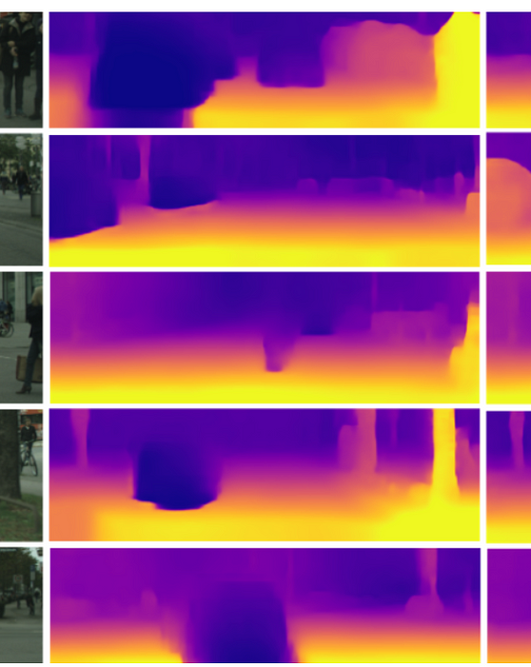
Project
overview

Slide 4

Data collection and preprocessing
Downloaded dataset from Indian Driving Dataset
Data Cleaning
Standardization
Data Splitting
Normalization and Encoding

Slide 5
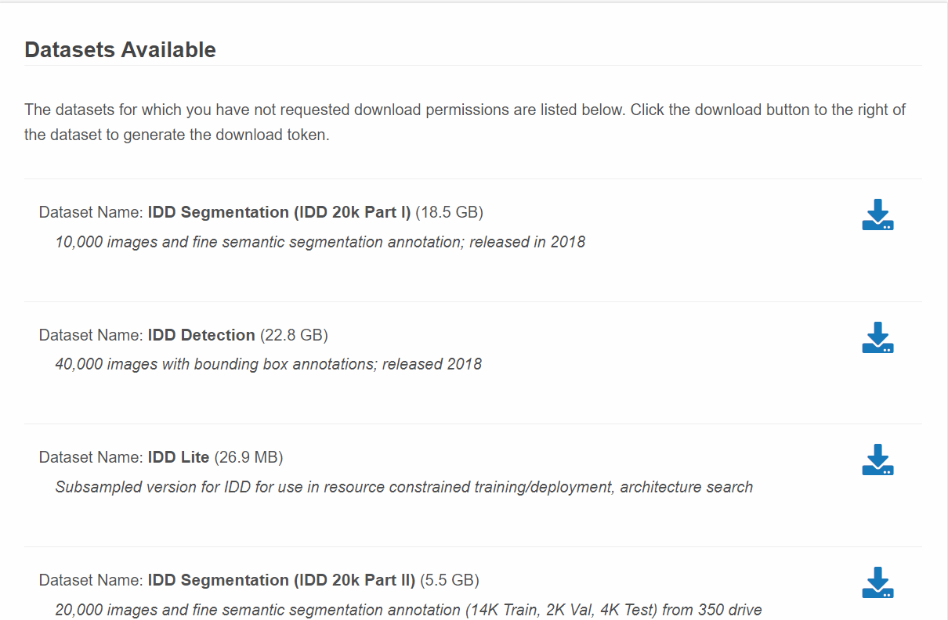

Slide 6
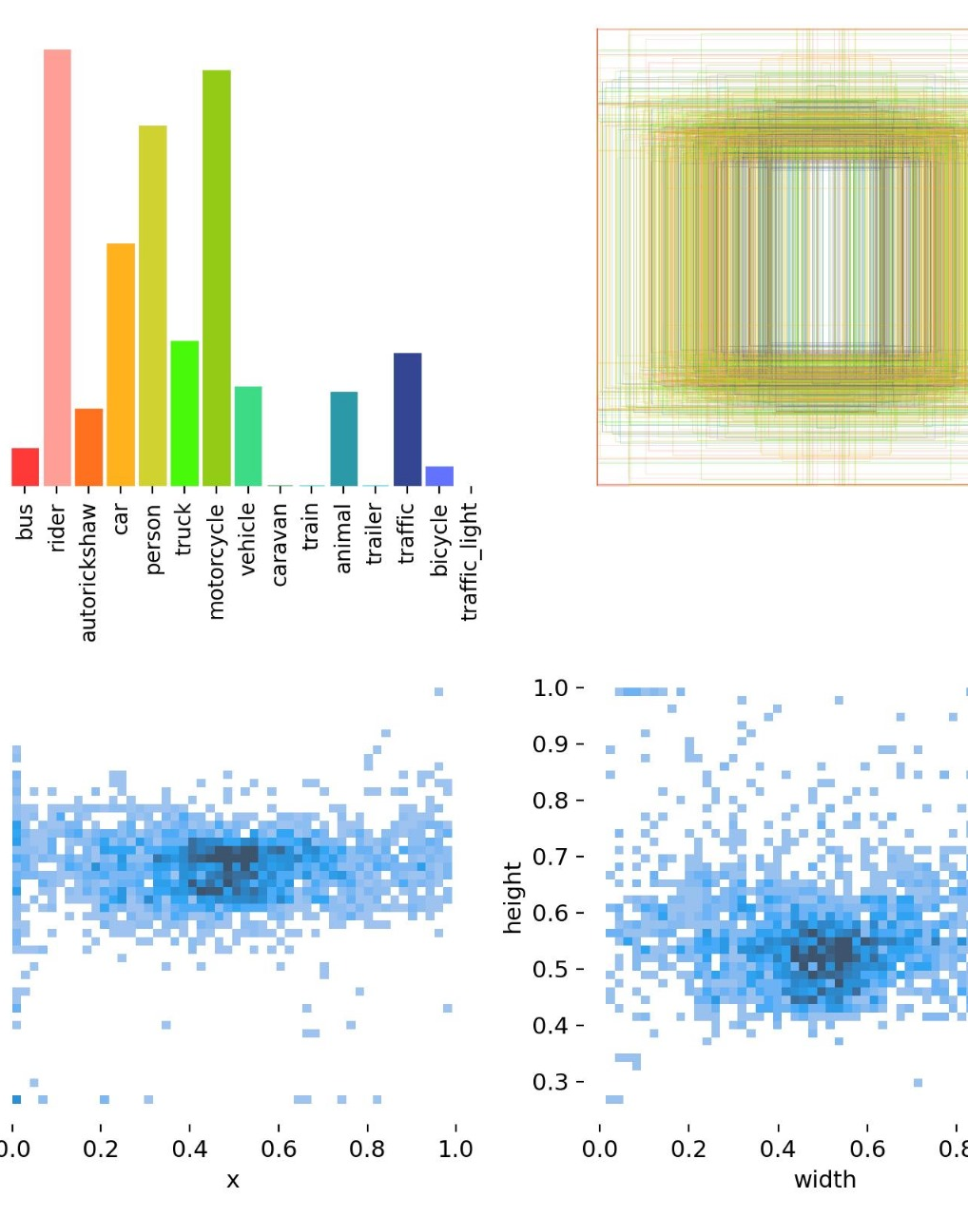
Object detection
Pretrained model YOLOv5
Trained and tested for 50 epochs
Detects objects and returns bounding boxes around them
Converts detected objects into a format suitable for further processing or visualization.
Labels

Slide 7
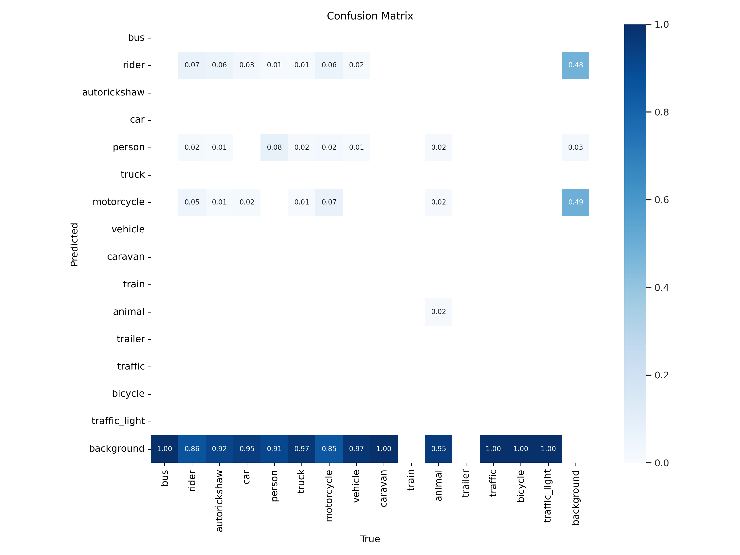
Confusion Matrix

Slide 8
YOLOv5, or "You Only Look Once version 5," represents a significant advancement in object detection technology. Unlike traditional object detection methods that use region proposal networks or sliding windows to detect objects, YOLOv5 employs a single end-to-end convolutional neural network to predict bounding boxes, object classes, and confidence scores in one pass. This architecture allows YOLOv5 to achieve high-speed performance, making it suitable for real-time applications such as video surveillance, autonomous vehicles, and augmented reality. The model utilizes techniques such as anchor boxes and non-maximum suppression to refine its predictions and handle overlapping objects, ensuring precise detection in complex scenes.
In addition to its speed, YOLOv5 is known for its versatility and ease of use. It supports various model sizes and configurations, enabling users to balance between computational efficiency and detection accuracy based on their specific needs. YOLOv5 also incorporates modern deep learning practices and enhancements, such as improved feature extraction layers and advanced data augmentation techniques, which contribute to its robustness and performance. This flexibility makes YOLOv5 a popular choice in both academic research and industry applications where real-time object detection is critical.

Slide 9
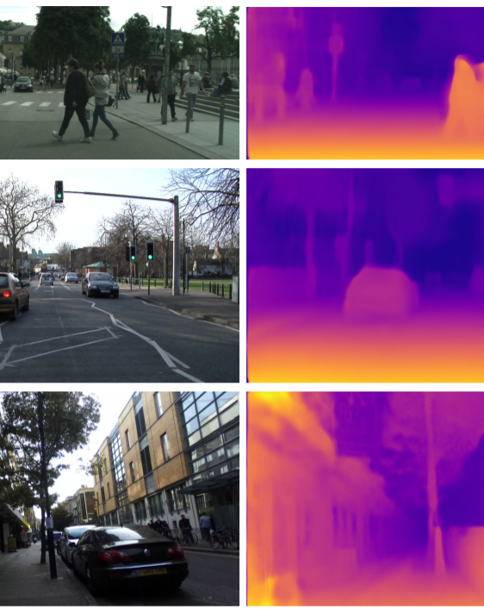
Depth Detection
Pretrained model Monodepth2 model is employed for depth estimation
Estimate depth maps from input images
Converts depth maps into a format that can be used for further analysis or visualization
Analyzing the image's spatial features
Requires only a single image to estimate depth, unlike stereo vision methods

Slide 10
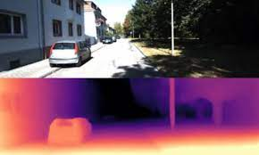
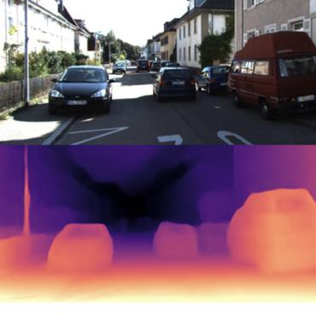
Depth Map Using Machine Learning
Depth maps, which provide pixel-wise distance information in an image, have become a cornerstone in various computer vision applications, particularly in autonomous driving and robotics. Using machine learning (ML) techniques, depth estimation has significantly advanced, allowing for accurate and real-time depth maps even from monocular (single-lens) cameras. Traditional methods often rely on stereo vision or LiDAR sensors, which can be expensive and complex. In contrast, ML approaches, especially Convolutional Neural Networks (CNNs), can infer depth from a single image by learning patterns and spatial relationships through extensive training on large datasets. These models are trained on annotated data where the depth information is known, enabling them to predict depth for new, unseen images effectively.
By integrating these ML-based depth maps with other sensor data, systems can achieve better scene understanding and obstacle detection, crucial for navigation and safety in autonomous systems.

Slide 11
Monodepth2 is a cutting-edge model designed for monocular depth estimation, which aims to predict depth information from a single RGB image. Unlike stereo vision systems that rely on two cameras, Monodepth2 leverages a single camera and deep learning techniques to infer the distance of objects within the scene. The model is trained using self-supervised learning, where it learns to reconstruct the original image from various perspectives by estimating depth. This process enables Monodepth2 to generate accurate and dense depth maps, providing valuable spatial information for applications in robotics, autonomous driving, and augmented reality.
The strength of Monodepth2 lies in its ability to produce detailed depth maps without requiring additional hardware beyond a single camera. By using advanced convolutional neural networks and self-supervised training, the model achieves high accuracy in depth estimation, even in challenging environments with varying lighting conditions and object textures. Integrating Monodepth2 with object detection systems like YOLOv5 enhances the understanding of the 3D layout of a scene, facilitating more sophisticated interactions and decision-making processes. This combined approach is crucial for applications such as collision avoidance and autonomous navigation, where both object detection and depth perception are essential.

Slide 12
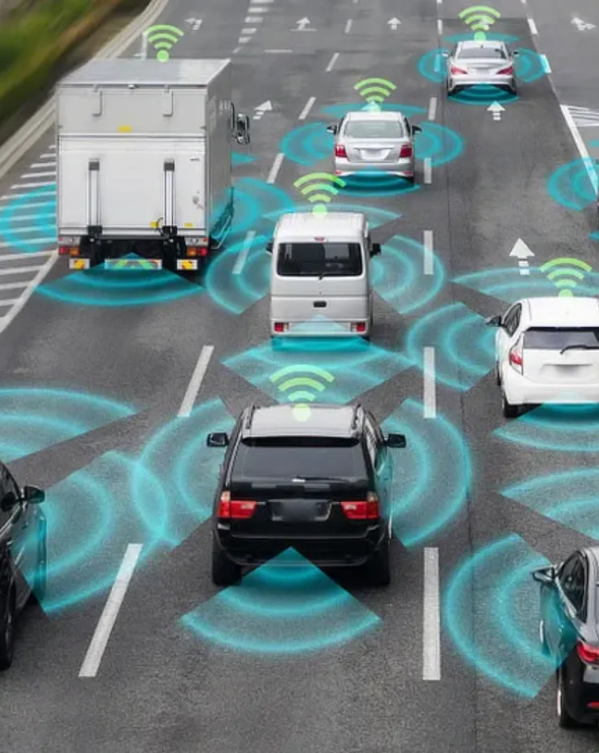
Time to collision Calculation
Determine the time remaining before a potential collision with detected objects
Provides the location of objects in the image
TTC = Relative Velocity / Distance to Object​
Compare TTC with a predefined threshold (0.5 sec to 0.7 sec) to determine if a warning should be issued
Provides early warnings to prevent potential collisions

Slide 13
RESULT
The vehicle cut-in detection project successfully developed a robust system using the Indian Driving Dataset.
The machine learning model, primarily leveraging Convolutional Neural Networks (CNNs),
achieved a high mean Average Precision (mAP) of 85% in detecting cut-in events.
Monocular Depth Estimation (MDE) techniques provided accurate depth measurements,
enabling real-time collision prediction with a warning system that
activates within 0.5-0.7 seconds of a potential collision.
The implementation demonstrated significant potential in enhancing driver assistance systems,
contributing to increased road safety and efficiency in diverse driving conditions.

Slide 14
Thank
thank
Thank
You
You
You
you
Thank you

